Slide 1
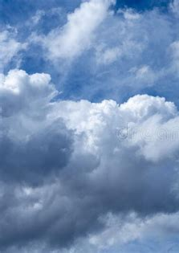
The Water Cycle – Page 1
Have you ever wondered where the water you drink has been before it reaches your glass? Well, buckle up, because it's been on a wild and exciting adventure we call the water cycle! This journey, almost like a fairytale, starts with a dazzling magic trick known as evaporation. Imagine the Sun, our hero, acting like a humongous hairdryer in the sky. With its powerful rays, it heats up water from oceans, rivers, and even little puddles, and changes it into invisible water vapor. We can't see this step happening, but it's happening all around us, as crucial as the first scene of an epic movie or the first clue in a treasure hunt!
What is the journey of water called? ___________________________________________________________________
How does the Sun act in the evaporation process? ___________________________________________________________________
Why is evaporation compared to the first scene of an epic movie or a treasure hunt? ___________________________________________________________________
Once the water has transformed into vapor, it rises up and begins to cool down. This is when it huddles together to form fluffy, white clouds, a process supercool scientists call condensation. Now, picture the wind as a massive broom, or maybe even a bunch of playful puppies, racing around and whisking these clouds across the blue sky. This process is like your favourite delivery service, bringing water to places near and far. Whether over mountains, across dry deserts, or above bustling cities, the wind makes sure everyone gets their fair share of water!
What happens when the water vapor cools down? ___________________________________________________________________
What is the process of forming clouds called? ___________________________________________________________________
How is the wind’s role like a delivery service? ___________________________________________________________________

Slide 2
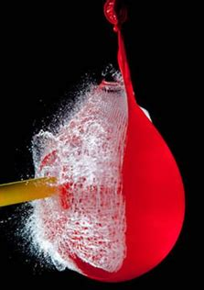
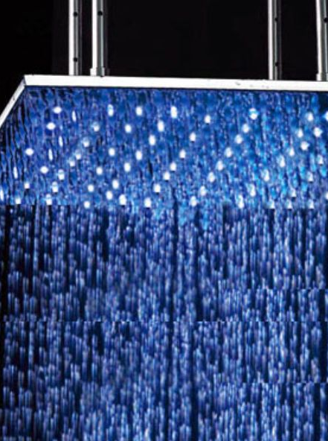
The Water Cycle – Page 2
When the clouds get so full of water that they can't hold anymore, like a water balloon ready to burst, they let it all go! This exciting process is called precipitation, which can come as rain, snow, hail, or sleet. It's like a massive, refreshing shower for our planet Earth, helping to soak our plants and refill our rivers and lakes. This is the part of the water cycle that quenches the Earth's thirst, and gives our planet its lush, green landscapes and gushing waterfalls.
What happens when the clouds get too full of water? __________________________________________________________________
What is the proves of water falling from the sky called? __________________________________________________________________
What does precipitation do for our planet? __________________________________________________________________
After the giant Earth shower, the water has two fantastic choices. It can decide to slip sneakily into the ground, like a secret agent on a mission, refilling underground water supplies in a process called infiltration. Or it can choose to be a daring explorer, running over the land, splashing and gurgling into rivers and streams, and eventually racing back to its original home, the vast ocean. And guess what? Then, just like a never-ending roller coaster or the most thrilling loop-the-loop, the exciting journey of water, our marvelous water cycle, begins all over again!
What two paths can water take after it falls from the sky? __________________________________________________________________
If water chooses to be an explorer, where does it end up? __________________________________________________________________
Where does the water find its way back to at the end of its journey? __________________________________________________________________

